Slide 1

KIKET IHLETETT MEG?

Slide 3
DIOR 2009
CHRISTIAN DIOR SPRING 2009 COUTURE COLLECTION
https://www.vogue.com/fashion-shows/spring-2009-couture/christian-dior/slideshow/collection#1

Slide 4
LADY GAGA 2010
https://www.flickr.com/photos/28470639@N02/4902766999
https://twitter.com/tomykmonster/status/791299788956246016

Slide 5
DOLCE & GABBANA 2012
https://www.vogue.com/fashion-shows/fall-2012-ready-to-wear/dolce-gabbana/slideshow/collection

Slide 6
MOSCHINO 2016 TAVASZI KOLLEKCIÓ
https://fashionisers.com/2015/09/25/moschino-spring-2016-rtw/

Slide 7
GUO PEI 2017
https://www.vogue.com/fashion-shows/spring-2017-couture/guo-pei/slideshow/collection#8

Slide 8
KING’S ANGELS D&G 2018
https://firstclassmagazine.us/kings-angels-dolce-gabbana-mens-fw18/

Slide 9
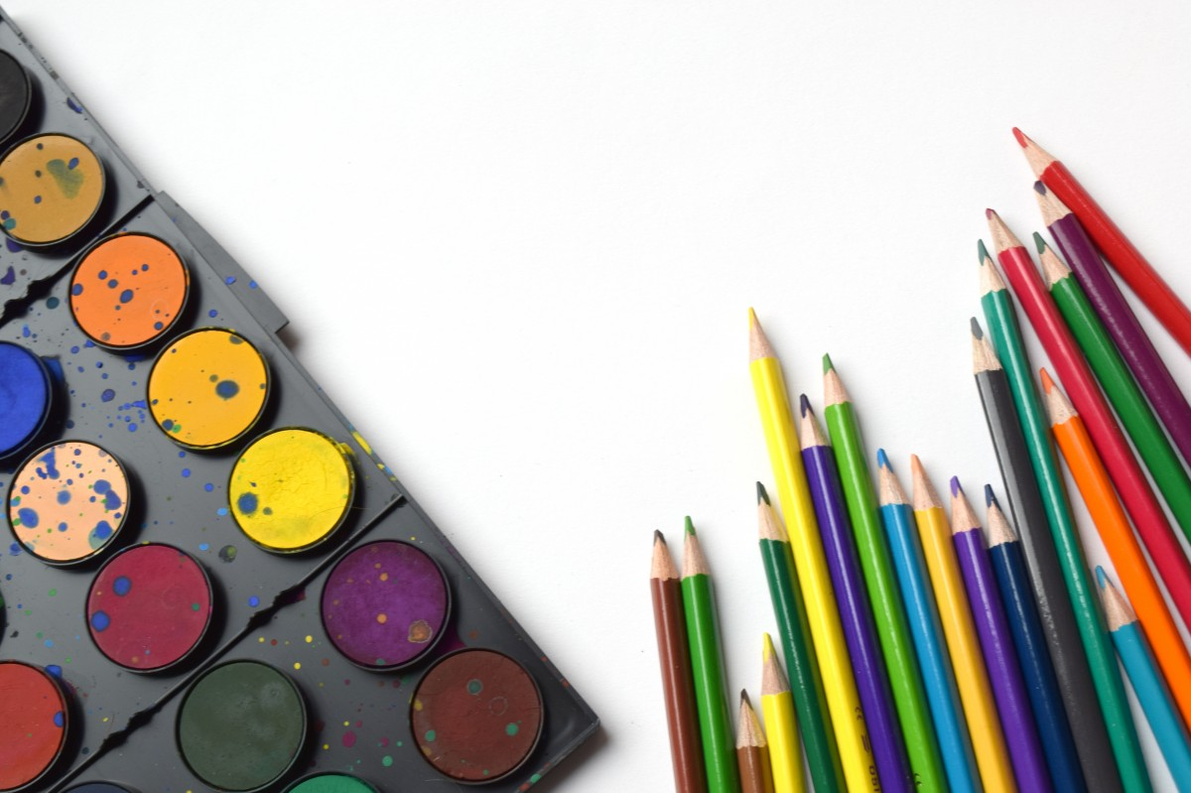
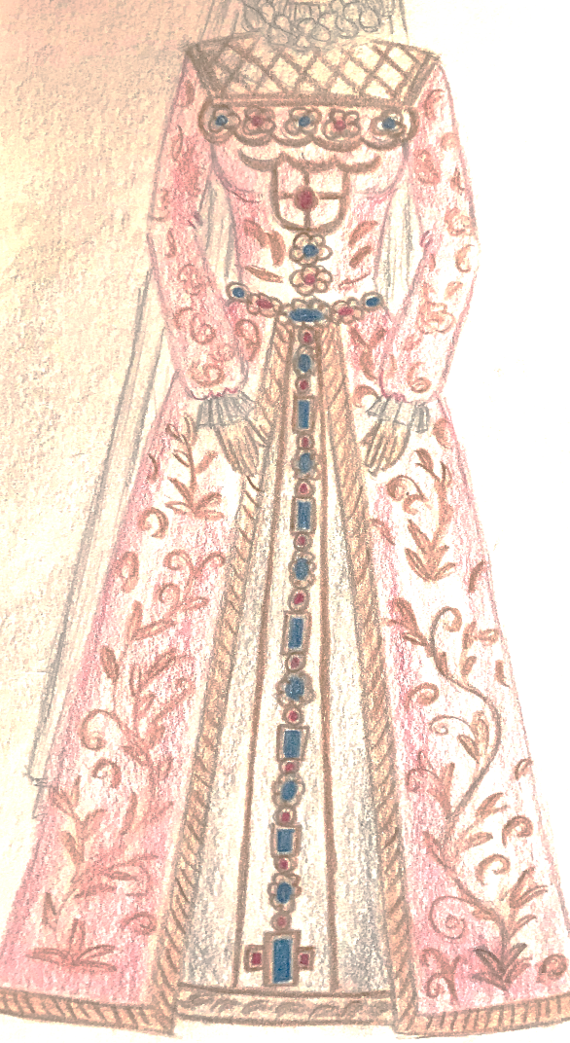
TERVEZÉSI FELADAT

